Slide 1
Assignment 2 CN2020

Slide 2
Assignment 2 Announcement

Slide 3
Specification (1/4)
In this assignment, you need to implement a simple Network Storage System, with these functions:
Client can watch a “.mpg” video (streaming) on the server
Client can upload files to server
Client can download files from server
Client can list what files are in the folder of server
For video steaming, you don’t need to send audio. You can just send raw frames (or encoded frames).
Video streaming requires buffering at both client side and server side. (bonus)
After upload and download, you need to ensure the files are identical between source and destination.
In this assignment, all the transmission should be implemented by the socket of TCP.

Slide 4
Specification (2/4)
You are required to write a Makefile for compilation. Thus, the command should be
$ make client // for client code
$ make server // for server code
After compilation, there should be 2 binary files named “client” and “server”
When we launch the server app, we will enter
$ ./server [port] // [port] will be determined
When we launch the client app, we will enter
$ ./client [ip:port] // ip is the ip address of server port is determined by the command above
After launching, client / server is required to create their own folders while any folder doesn’t exist.

Slide 5
Specification (3/4)
Server is required to support multiple connections. That is, there can be more than 1 client connecting to the server simultaneously.
After building up of a connection, a user can enter the commands below on the client,
$ ls // Then, the client’s will print out what files is in the server’s folder.
$ put <filename> // Then, the client will upload the file with the <filename> to the server’s folder
$ get <filename> // Then, the client will download the file with the <filename> to the client’s folder
$ play <videofile> // Then, the client will play the <videofile> from the buffer at server side to the client

Slide 6
Specification (4/4)
If the command doesn’t exist or the command format is wrong, please print out “Command not found.” or “Command format error.” on the client.
If the file doesn’t exist while putting or getting a file, please print out “The ‘<filename>’ doesn’t exist.” on the client.
If the video file is not a “.mpg” file while playing a video file, please print out “The ‘<videofile>’ is not a mpg file.”
Client should be able to send another command after a command is finished.
The multiple connections should be implemented with pthread.h, while the video player should be implemented with OpenCV.
The implementation must be in C or C++.

Slide 7
Grading Policy (1/3)
This assignment accounts for 12% of the total score.
Command Sending (10%)
The client sends commands correctly (5%)
The client prints out responses correctly (5%)
Video Streaming (25%)
Correctly play a 720p Video (1280*720) (5%)
Correctly play a resolution-unknown video (10%)
(That is, client has no idea about the resolution of the video before requesting a video to play.)
Correctly implement frame encoding/decoding (10%)
If you only send raw frames (5%)
(Bonus 10%) Correctly implement buffering
File Transferring (25%)
There would be 5 files with different sizes (5% * 5)
(You will get 0 point in a testcase if the transfer of a testcase is terminated or halts before finished, or the files are not identical between source and destination after the transfer.)

Slide 8
Grading Policy (2/3)
Multiple Connections (20%)
Use <pthread.h> to achieve this function (basic) (10%)
Use select() to achieve this function (advance) (20%)
You just need to choose one of above to implement.
Report (20%)
Draw a flowchart of the video streaming and explains how it works in detail. (5%)
Draw a flowchart of the file transferring and explains how it works in detail. (5%)
What is SIGPIPE? It is possible to happen to your (5%) code? If so, how do you handle it?
Is blocking I/O equal to synchronized I/O? Please (5%) give me some examples to explain it.

Slide 9
Grading Policy (3/3)
Submission
Your report format must be in “.pdf” format and named “report.pdf”, or else you will get zero point in the part.
Please put all the files into a folder named hw2_<student id>, and compress the folder as a .zip file, and then submit the .zip file to NTU Cool. The filename is hw2_<student id>.zip (alphabets in lowercase).
If we cannot compile or execute your code, you will have a chance to demo your results in your own environment.
The penalty for wrong format is 10 points.
No plagiarism is allowed. A plagiarist will be graded zero.
Deadline
Deadline: 23:59:59, December 15th, 2020 (get * 0.9 points)
Penalty for late submission is “10% per day” .

Slide 10
Environment Setup

Slide 11
Environment
We provide a VirtualBox environment for you to run our binary code and you can run Wireshark on this environment.
If you would like to setup the environment on your OS rather than our virtual machine, here is information of our environment
Ubuntu 16.04 x64
OpenCV 3.3.1 (will be also required in later Assignments)
You can install OpenCV 3.3.1 by following the instruction here.

Slide 12
VirtualBox Setup
Download the VM from
our server
our Google Drive,
Install Virtualbox (natively installed on the computers of Lab R204).

Slide 13
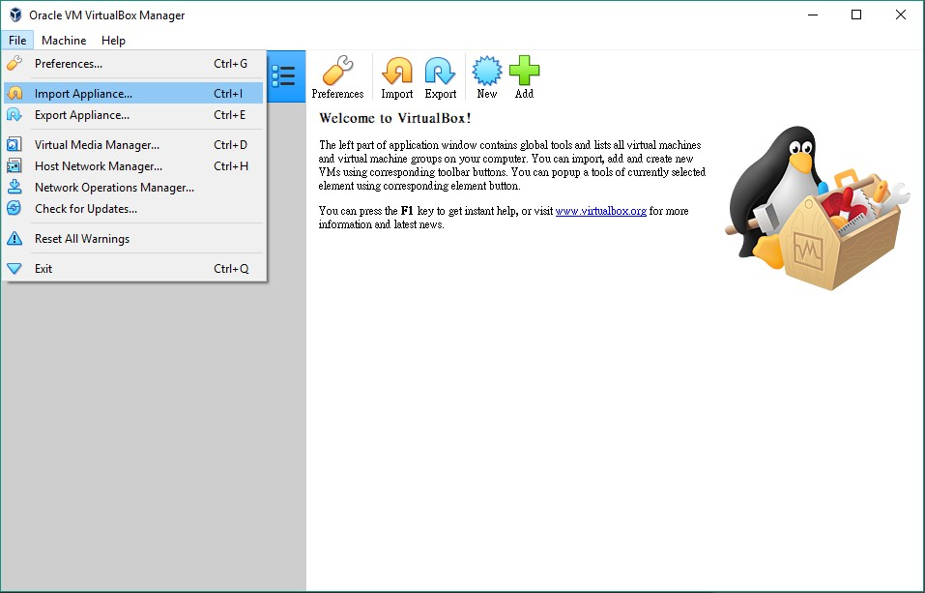
VirtualBox Setup
Go to “File” and click “Import Appliance” to import the “CN-Ubuntu_16.04_x64.ova”

Slide 14
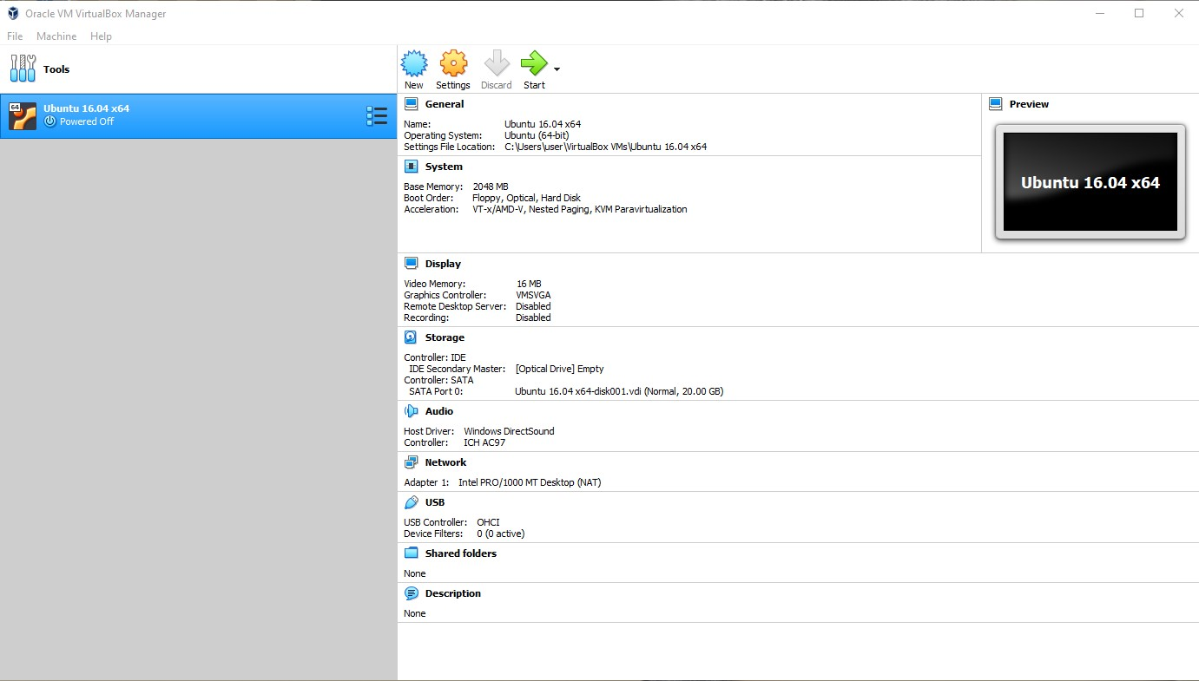
VirtualBox Setup
Choose “Ubuntu 16.04 x64” and then start the machine.

Slide 15
Auxiliary Libraries

Slide 16
Example code
SocketExample/
├── client.cpp
├── server.cpp
├── Makefile
├── tmp.mpg
├── pthread.cpp
├── openCV.cpp
└── ffmpegExample/
├── ffmpegExample.c
├── ffmpeg_install.sh
// You have learned

Slide 17
Pthread
Pthead, i.e., POSIX Thread, is used to implement multi-thread parallelization in POSIX environment.
You can use pthread to achieve multiple connections.
You don’t need to deal with synchronization issues, i.e., in our testcases, it won’t put a video with the same file name.
An example code in pthread.cpp
To compile with Pthread,
$ g++ <file name> -o <output name> -pthread

Slide 18
select()
Select() provides you to supervise multiple sockets, telling you which is able to read or write, etc.
With select(), it is possible to achieve Asynchronous Blocking I/O.
For more details about I/O, you can go to this website. (Report 4)
If you want to implement this assignment with select(), please refer to this website.

Slide 19
select()
Monitor whether there is at least one fd available
#include <unistd.h> int select(int nfds, fd_set*, readfds, fd_set* writefds, fd_set* exceptfds, struct timeval* timeout); //return : 1 if it’s success, -1 otherwise
nfds: specifies number of file descriptors to monitor.
readfds: specifies the pointer to read file descriptor list
writefds: specifies the pointer to write file descriptor list
exceptfds: specifies the pointer to error file descriptor list
timeout: deadline for select().

Slide 20
select()
void FD_SET(int fd, fd_set *set); void FD_CLR(int fd, fd_set *set); int FD_ISSET(int fd, fd_set *set); // return: 1 if it’s available, else: 0 void FD_ZERO(fd_set *set);
FD_SET: Add the file descriptor into the set
FD_CLR: Remove the file descriptor from the set
FD_ISSET: Check if the file descriptor is available
FD_ZERO: Clear the set

Slide 21
OpenCV
Is an opensource library for computer vision.
Mat is an image container to load an image so that you can easy to do image processing, recognition, etc.
In this assignment, we use this library to get frames from videos on server, and show frames on client.
An example code in openCV.cpp. tmp.mpg is an .mpg video file if you need.
To compile code with OpenCV,
$ g++ <file name> -o <output name> \ `pkg-config –cflags –libs opencv`

Slide 22
FFmpeg
Is an opensource library for encoding / decoding video and radio.
AVPacket is the slices of data, so that we can use AVCodec to decode AVPacket into frame.
In this assignment, we use this library to get AVPacket and AVCodec from videos on server, and Using them to decode into frames and showing on client.
An example code in ffmpeg.c, ffmpeg_install.sh is a script to install ffmpeg lib.

Slide 23
Installation
$ bash ffmpeg_install.sh
ffmpegExample/
├── ffmpegExample.c
├── ffmpeg_install.sh
└── ffmpeg/
└── ffmpeg3.3/
├── ffmpeg-lib/
└── many many other files

Slide 24
Compile
// please copy ffmpeg-lib/ folder to ffmpegExample/
// like this:
ffmpegExample/
├── ffmpegExample.c
└── ffmpeg-lib/
$ export LD_LIBRARY_PATH=ffmpeg-lib/lib
$ gcc -I ffmpeg-lib/inc ffmpegExample.c -L ffmpeg-lib/lib -lavdevice -lavfilter -lavformat -lavcodec -lswresample -lswscale -lavutil -o ffmpegExample.out

Slide 25
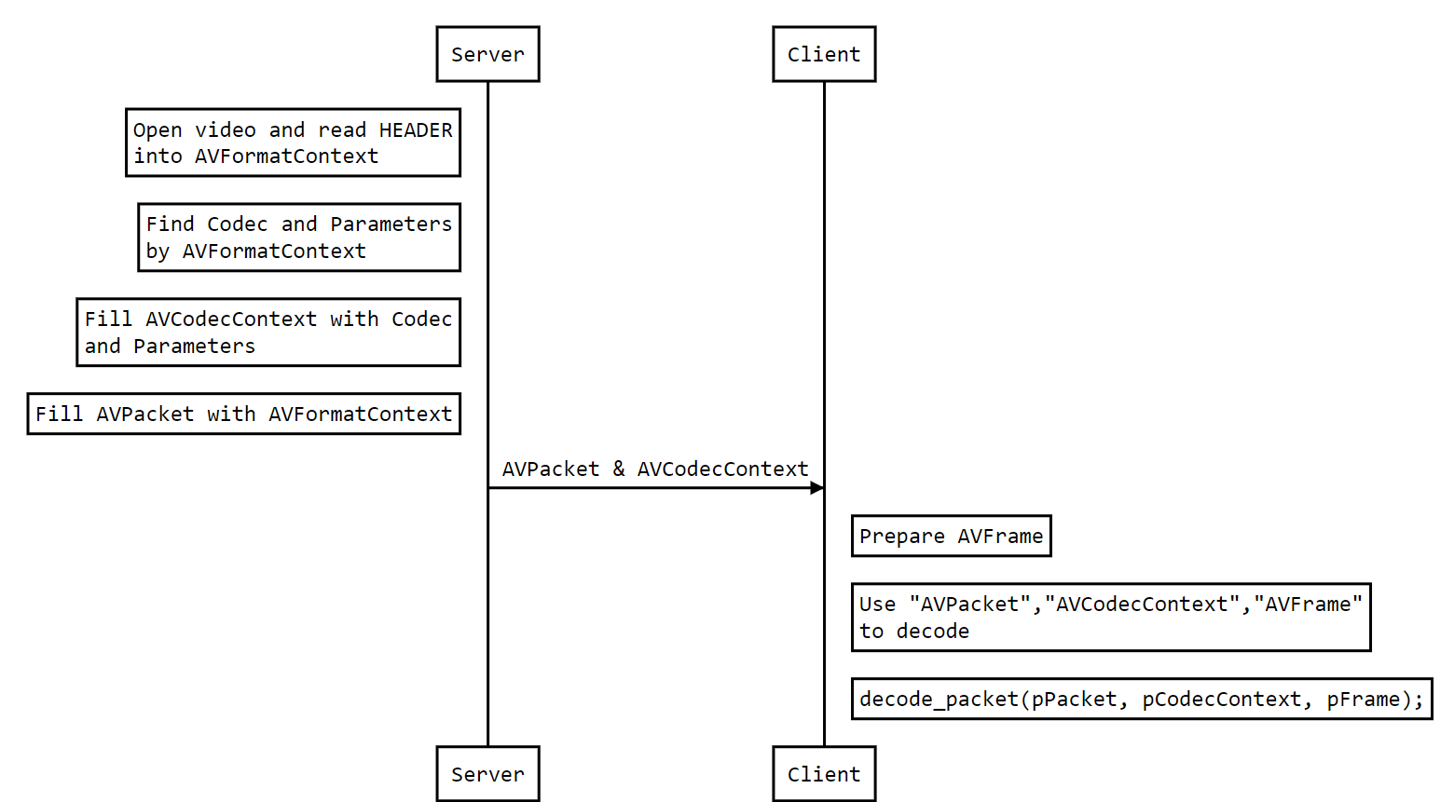
FFmpeg

Slide 26
Reference
Beej’s Guide to Network Programming (中文)
Beej’s Guide to Network Programming (English)

